Slide 1
Azure Defender for IoT
100.4 Tuning and Platform Optimization

Slide 2
Agenda
Step 1 - Pre-Run Risk Assessment
Step 2 – Review Alerts
Step 3 – Review Public Addresses
Step 4 – Review Notifications
Step 5 – Define Subnets
Step 6 – Define Important Devices
Step 7 – Import Authorized Assets List
Step 8 - Run Optimized Risk Assessment Report
Notes:
Point out website

Slide 3
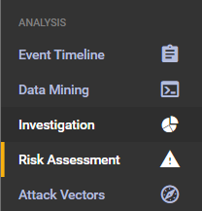
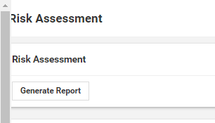
Step 1 - Pre-Run Risk Assessment Report
To create a good Risk Assessment report, we are required to do some initial tuning to optimize the D-IoT platform to customer’s environment
To make sure that our tuning makes a difference, we will generate an initial report before we make any changes
Click Risk Assessment on navigation bar
Click on Generate Report
Download the report and change the name to Risk-Assessment-old.pdf

Slide 4
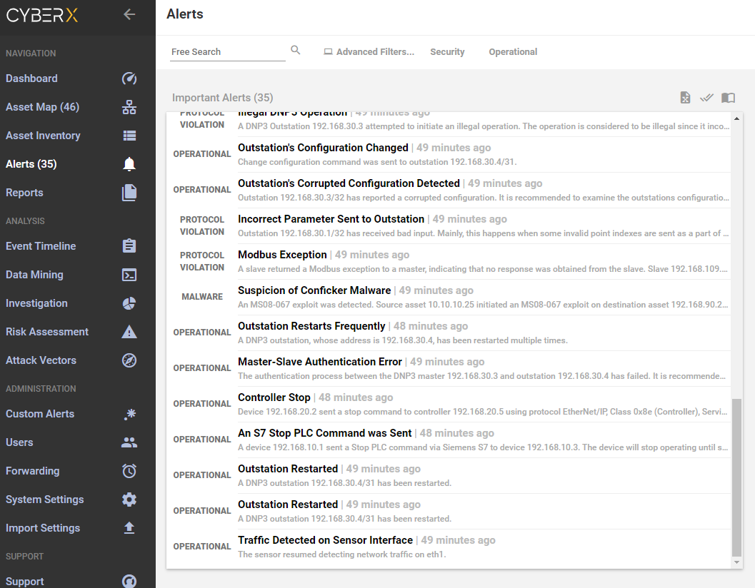
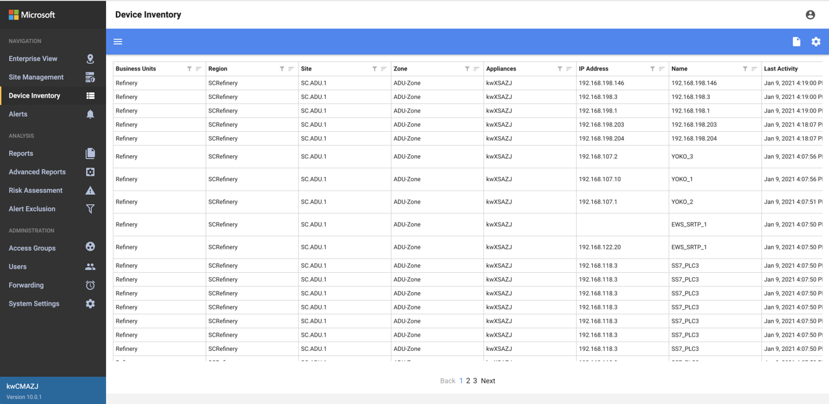
Step 2 – Review Alerts
Review the alerts and Learn/Acknowledge accordingly:
Customer said that today during maintenance he sent a Stop command to his Siemens PLC (192.168.10.3)
During that maintenance he also upgraded the Honeywell Firmware Version to device 192.168.30.2

Slide 5
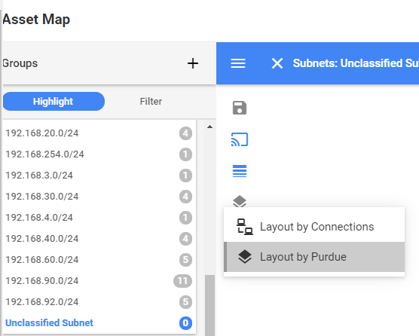
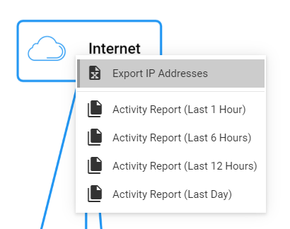
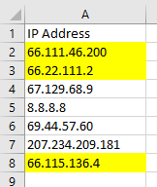
Step 3 – Review Public Addresses
In some case the customer is using a Public address range as Private in his organization.
Export the Public address list and show it to the customer
Click on Asset Map
Click on Layout Options Button and select Layout by Purdue
Right click on the Internet asset on the map and select Export IP Addresses
Showing this to the customer, he immediately identified that 66.x.x.x/8 is his internal subnet that used for Production line 3
Go to System Settings
Click on Subnets
Add subnet 66.0.0.0, 255.0.0.0, give a name “Prod Line 3” and mark ICS Subnet
Layout options

Slide 6
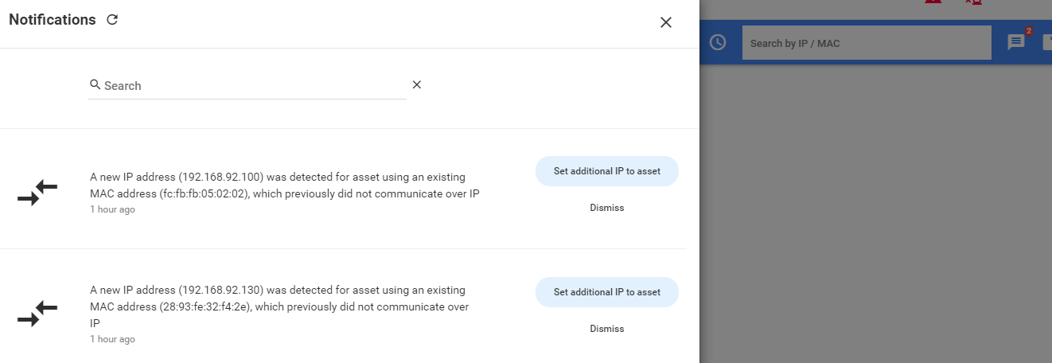
Step 4 – Review Notifications
Azure Defender platform notifying on changes in assets.
Those changes can be a part of device data enrichment or changes in device configuration.
Review and select the relevant system recommendation
Go to Asset Map
Click on Notification Icon
Assign new IP addresses to the devices

Slide 7
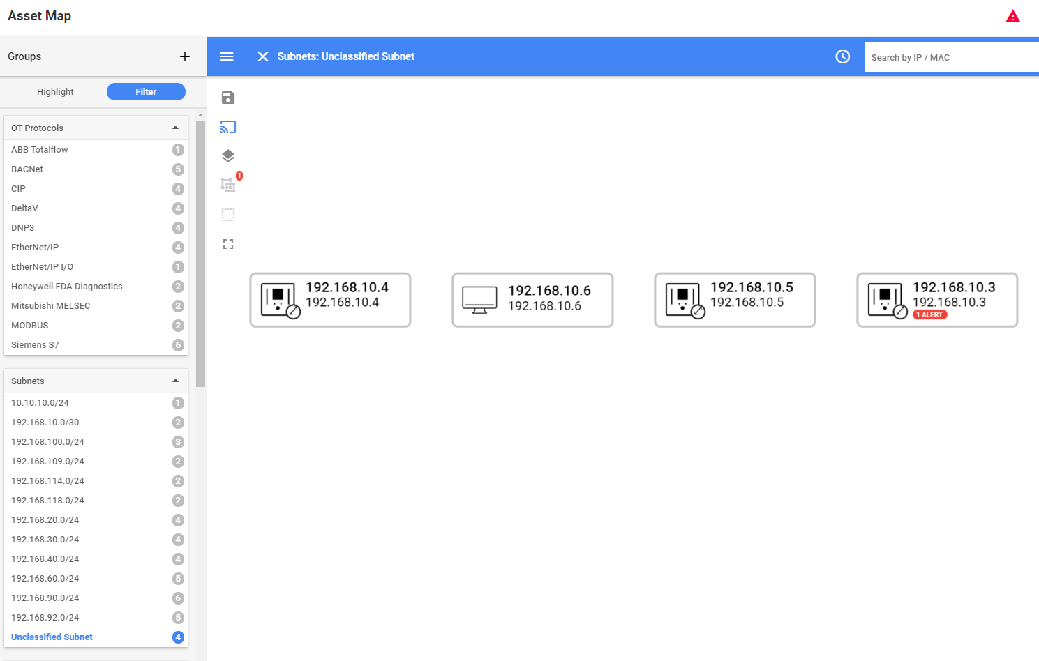
Step 5 – Define Subnets
Azure Defender is passive traffic monitoring platform, it will identify asset and network properties, but the Subnet Masks must be configured manually, this information is not available in the traffic.
Azure Defender configure all the Subnet Mask to be Class C by default.
Review the Subnets that were discovered and adjust the Mask of 192.168.10.x according to Customer’s network
Go to System Settings
Click on Subnets
Change the Mask of the 192.168.10.0 subnet to 255.255.255.252
Save
Go to the Asset Map and open Groups
Select Unclassified Subnet and Filter
We see that there are devices that unclassified

Slide 8
Step 5 – Define Subnets
CyberX is passive traffic monitoring platform, it will identify asset and network properties, but the Subnet Masks must be configured manually, this information is not available in the traffic.
CyberX configure all the Subnet Mask to be Class C by default.
Review the Subnets that were discovered and adjust the Mask of 192.168.10.x according to Customer’s network
We see that there are devices that unclassified
Go to System Settings
Click on Subnets
Change the Mask of the 192.168.10.0 subnet to 255.255.255.252
Save
Go to the Asset Map and open Groups
Select Unclassified Subnet and Filter

Slide 9
Step 6 – Define Important Devices
We know that there are assent in the customers network that are more important than others.
Azure Defender allow to mark devices as “Crown Jewel” to be calculated with higher risk score.
Those “Crown Jewel” devices are ones that if they will be compromised it will do significant damage to customer’s network and/or the organization.
Go to Asset Map
Right click on a device and select Mark as Important
Repeat this action for all the PLCs in subnets:
192.168.20.0
192.168.40.0
192.168.60.0

Slide 10
Step 6 – Define Important Devices
We know that there are assent in the customers network that are more important than others.
CyberX allow to mark devices as “Crown Jewel” to be calculated with higher risk score.
Those “Crown Jewel” devices are ones that if they will be compromised it will do significant damage to customer’s network and/or the organization
Go to Asset Map
Right click on a device and select Mark as Important
Repeat this action for all the PLCs in subnets:
192.168.20.0
192.168.40.0
192.168.60.0

Slide 11
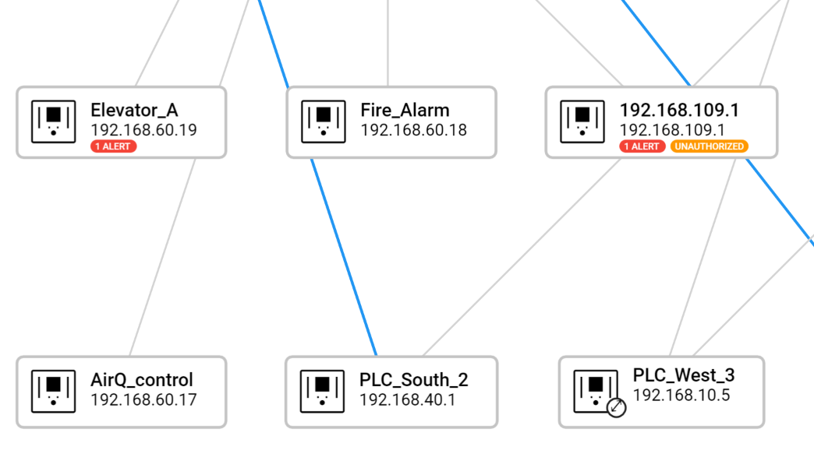
Step 7 – Import Authorized Assets List
In case the customer is managing his own list of assets, you can upload it into Azure Defender platform is CSV format
The imported list will update the assets names
In case Azure Defender will discover devices that are not part of customer’s list, those devices will be marked as Unauthorized
Download Authorized_Devices.csv file
Go to Import Settings
Add the Authorized_Devices.csv file to Authorized Assets
Go to Asset Map and make sure that most of devices have a names
Highlight Unauthorized Assets

Slide 12
Step 8 - Run Optimized Risk Assessment Report
After we finished the tuning and optimization of the system its time to generate additional report
Click Risk Assessment on navigation bar
Click on Generate Report
Download the report and change the name to Risk-Assessment-new.pdf

Slide 13
Thank you

